Slide 1





SCIENTIFIC CONFERENCE
National Public Health Convergence
Securing Tomorrow, Strengthening Public Health Through Science and Sustainable Intervention in The Gambia
7th October 2026 • Banjul, The Gambia

Slide 2
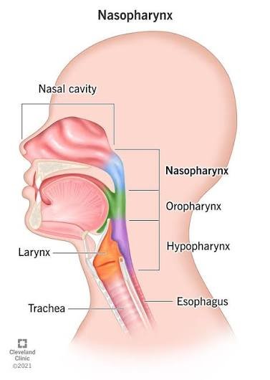
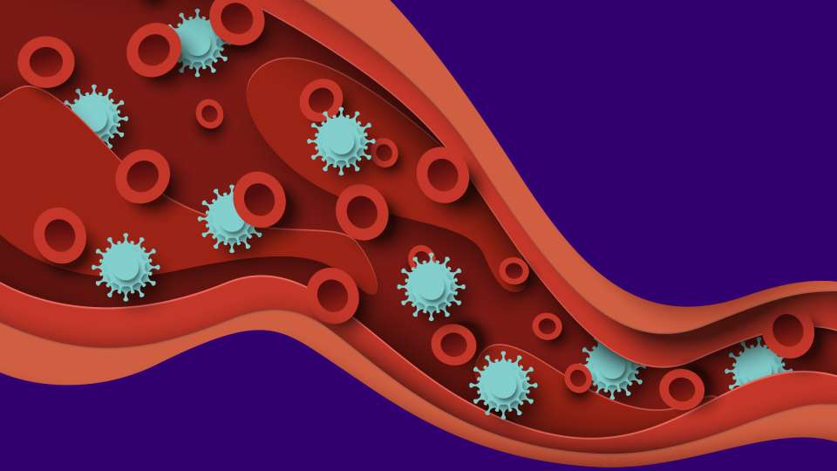
Part 1 of 5
Is nasopharyngeal carriage of Staphylococcus aureus associated with invasive disease in the same patient?
Sulayman Sowe BSc
MRC Unit The Gambia at the London School of Hygiene & Tropical Medicine
Can the bloodstream isolate be matched to the nasopharyngeal isolate from the same patient?
1

Slide 3
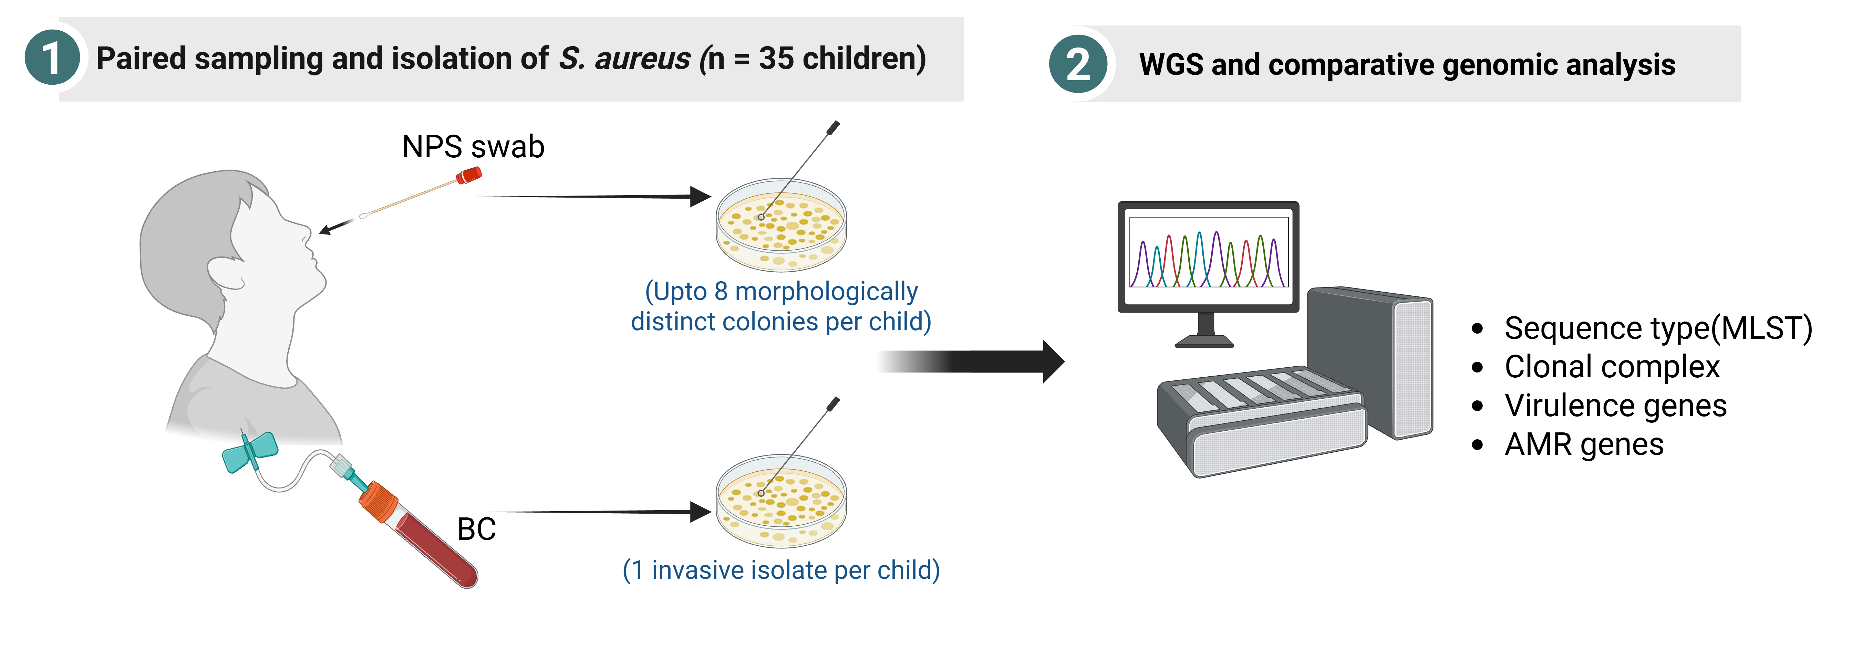
Study Design
Part 2 of 5
BC vs. NPS isolates
2

Slide 4
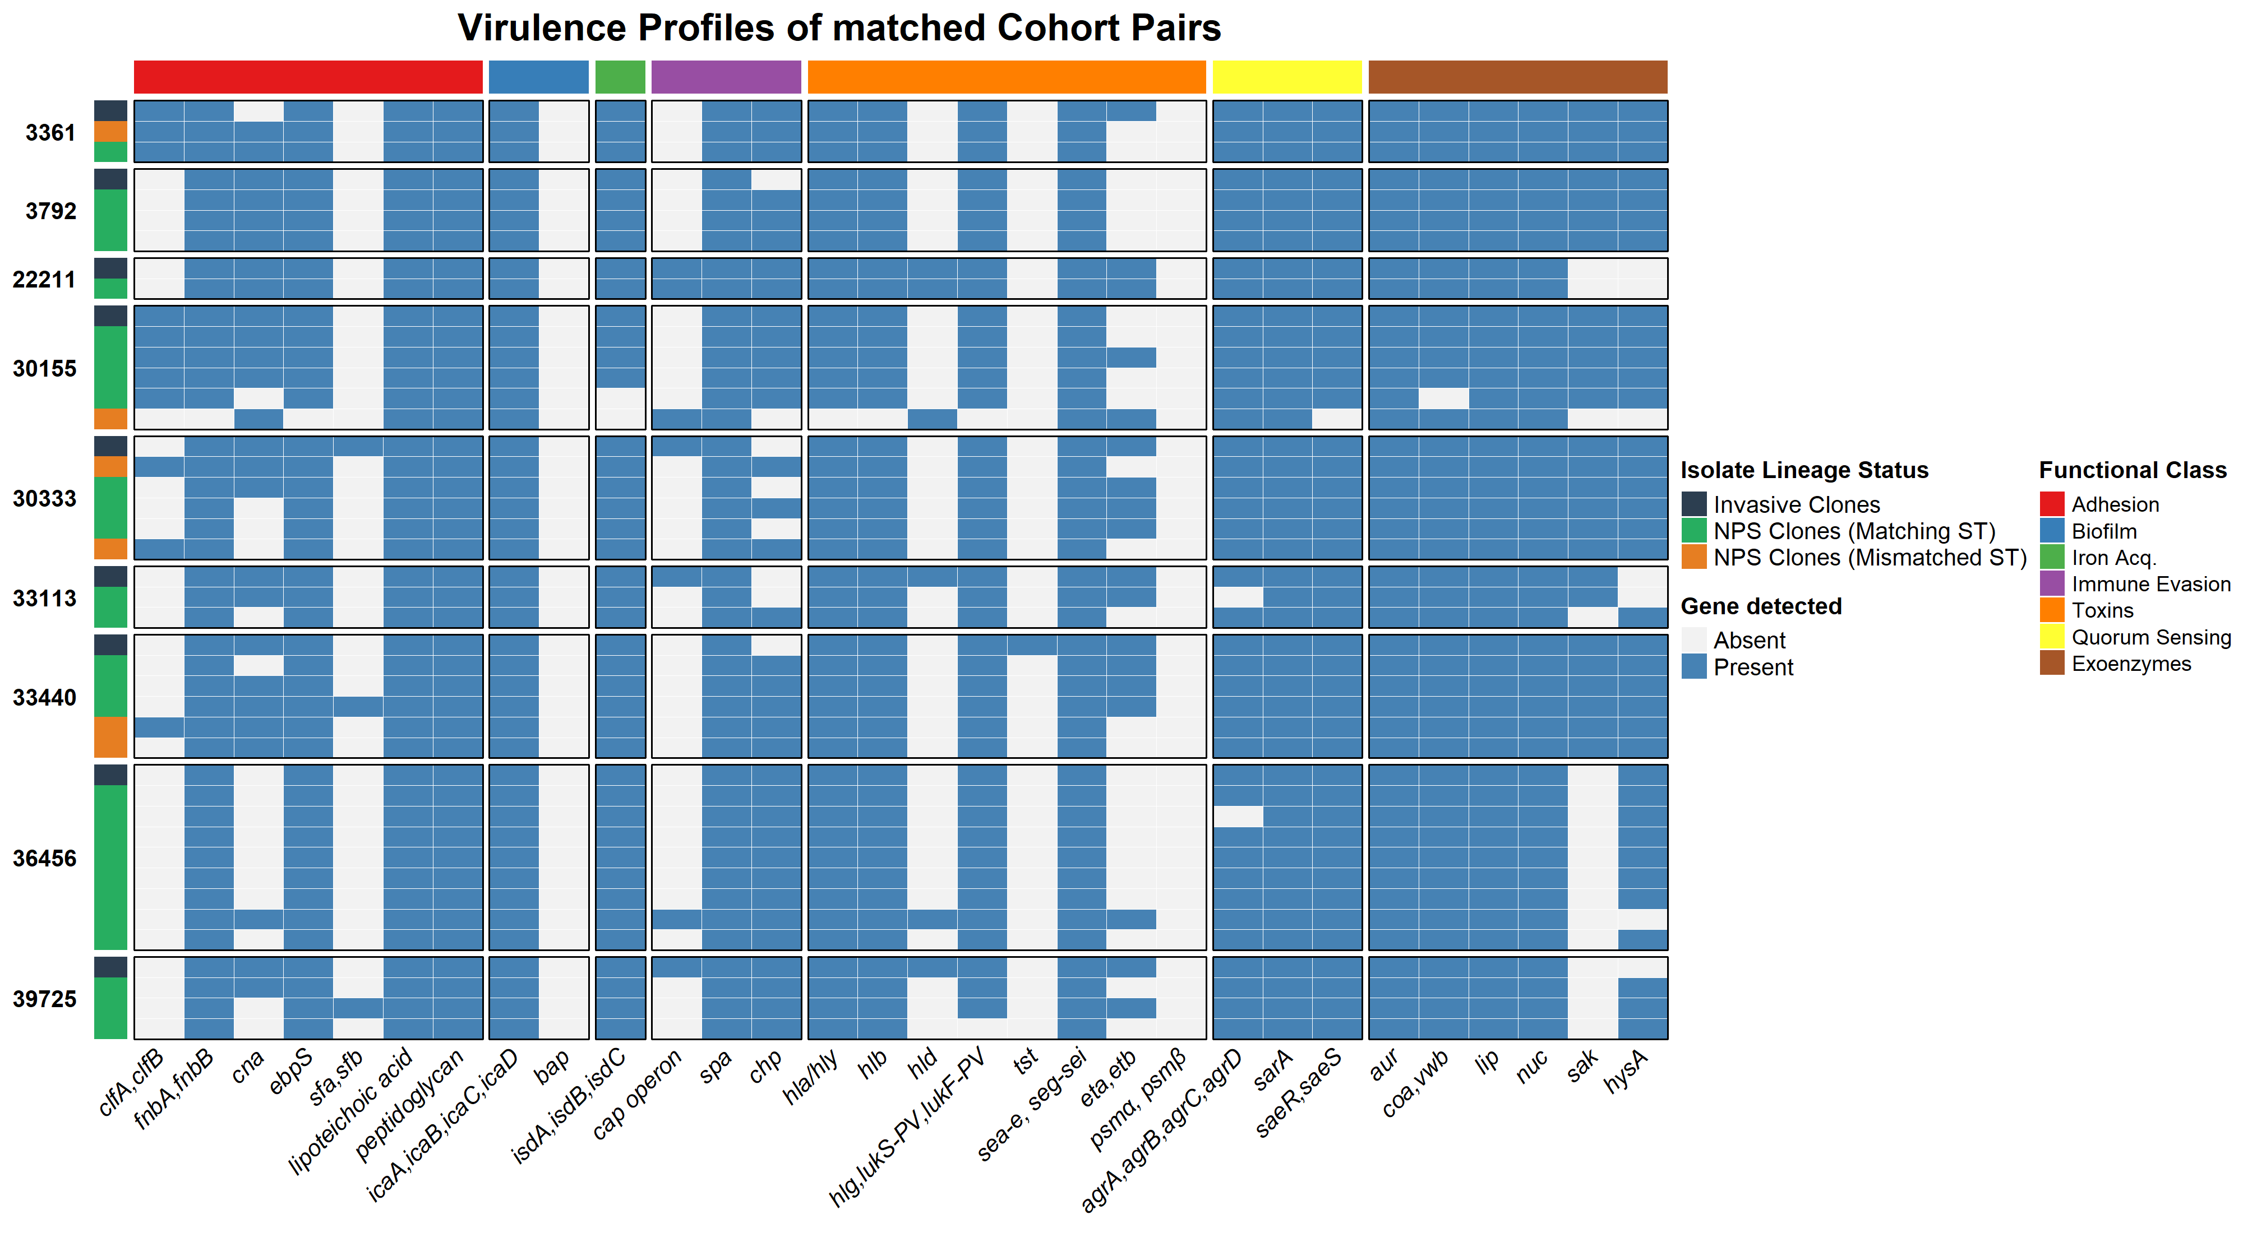
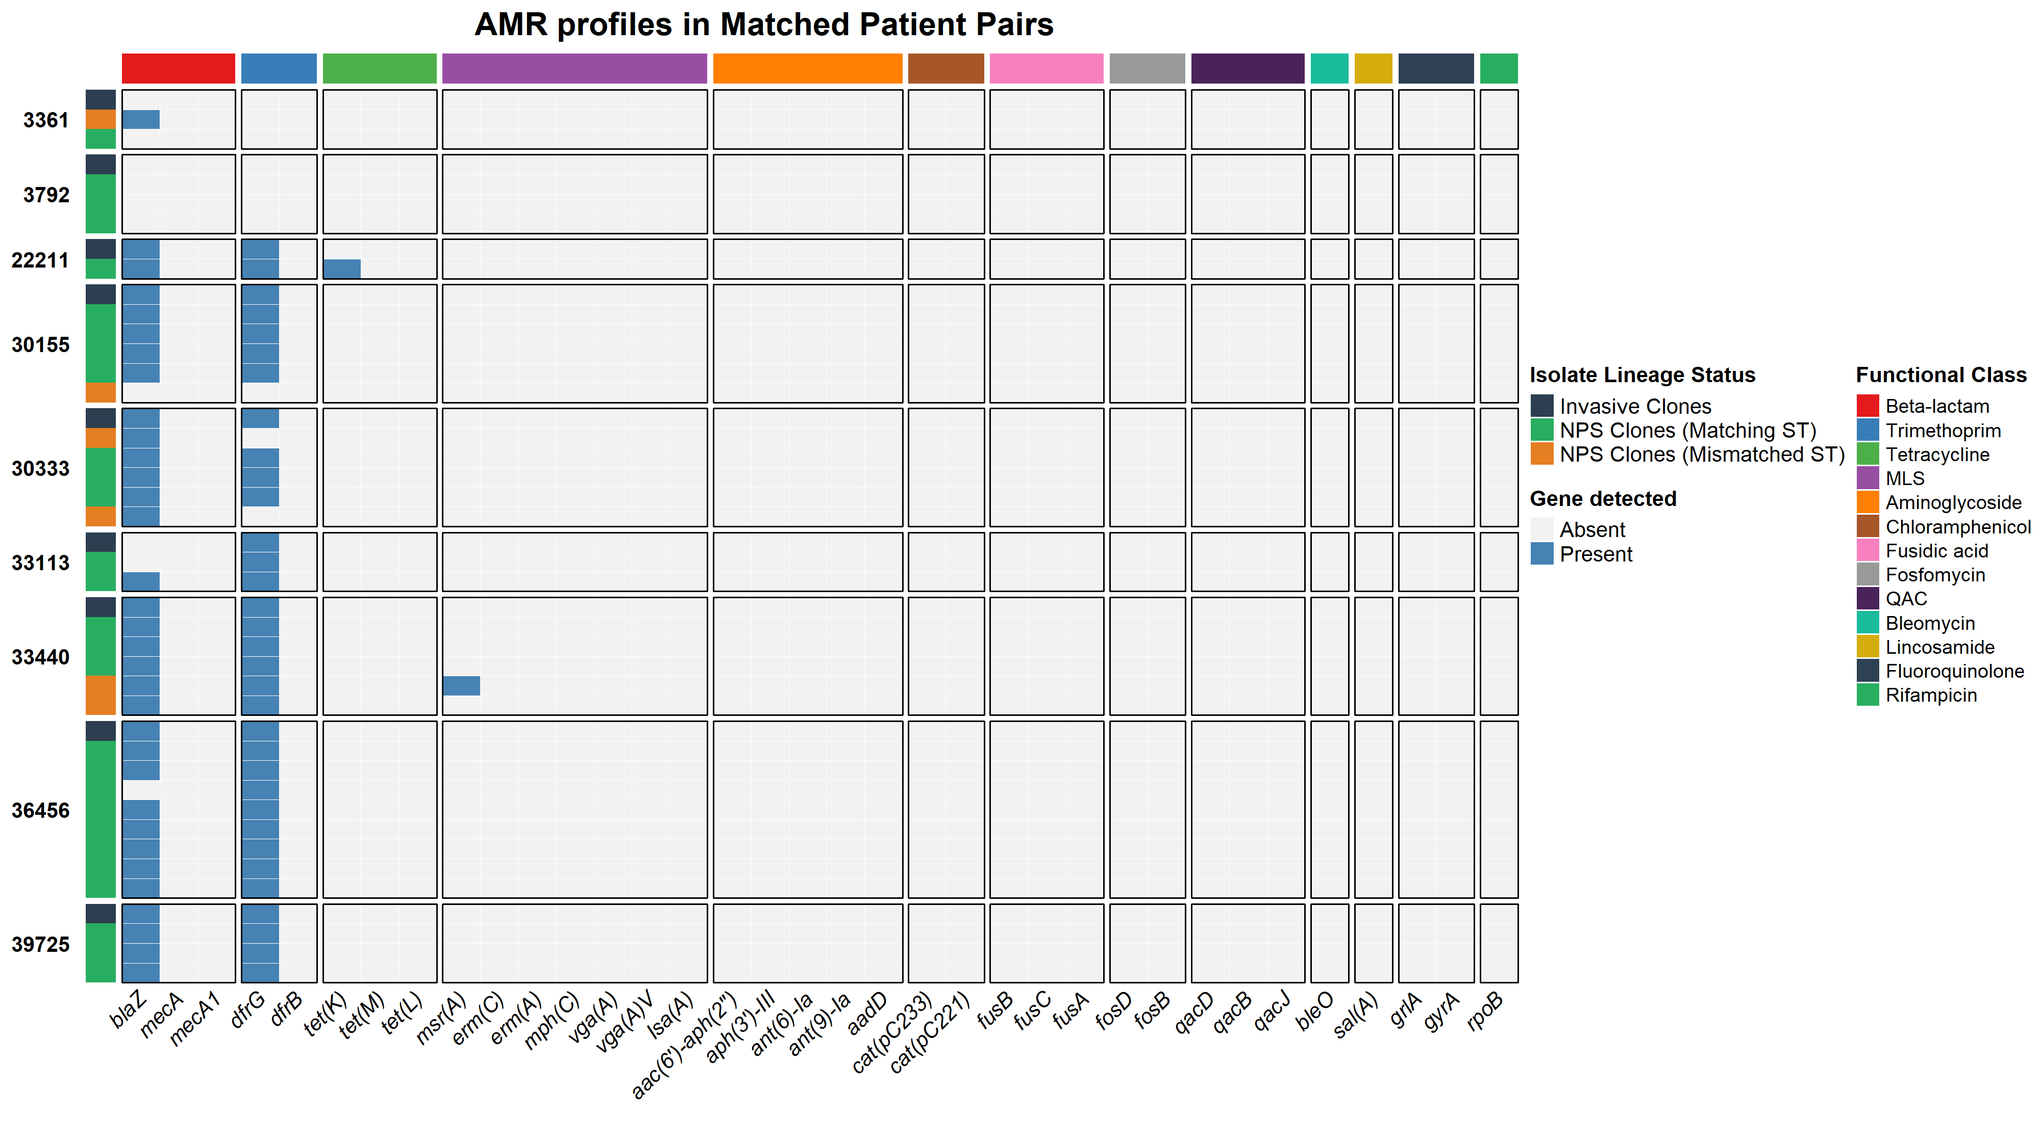
Findings
Part 3 of 5
9/35 (26%) patients has the same ST in BC and NPS
CC15 and CC152 were
the dominant lineages
3

Slide 5
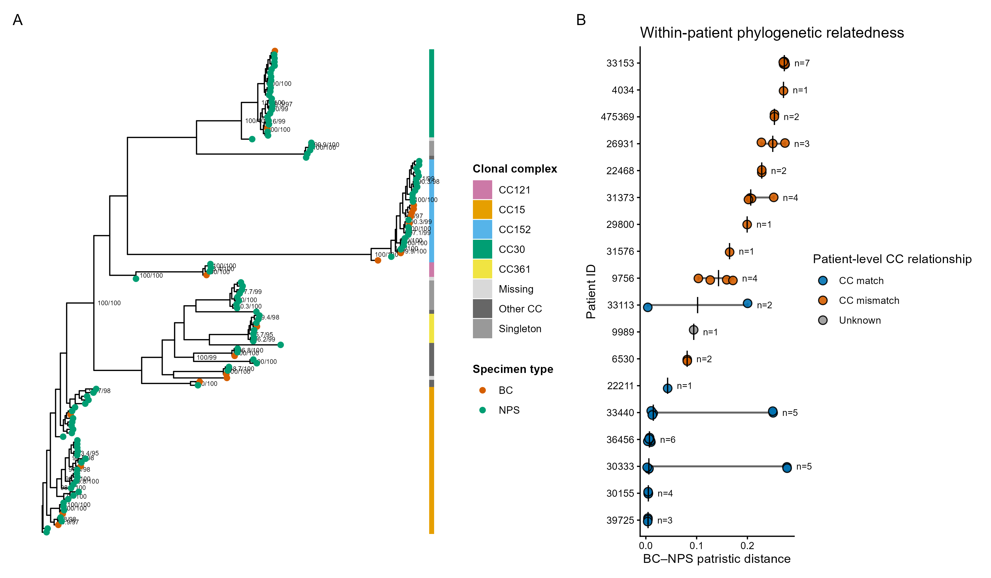
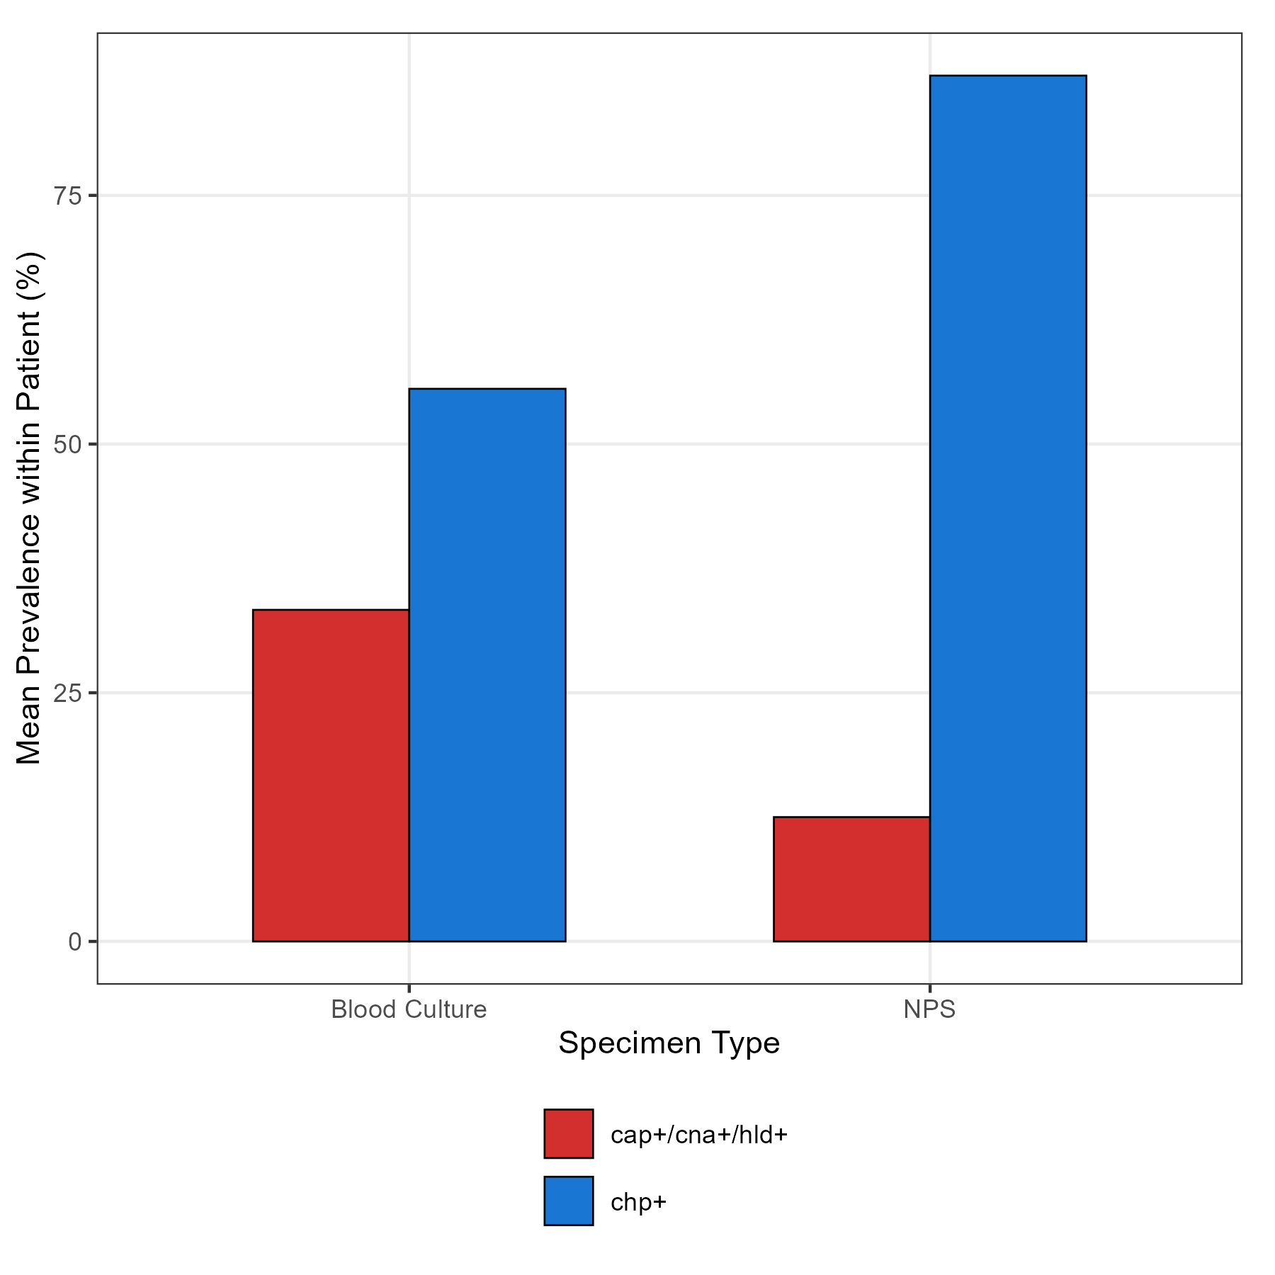
Part 4 of 5
The cap operon, cna, and hld genes produce specific proteins that help bacteria hide from the immune system, stick tightly to body tissues, and damage host cells.
Abdoulie Bojang et al. (2024) BMC Infect Dis.
The chp gene encodes the Chemotaxis Inhibitory Protein which plays a key role in evading the human immune system to establish successful bacterial carriage and colonization
Matched STs showed shorter BC–NPS
Patristic distances
Alex J McCarthy et al. (2012) Frontiers in Cell Infect Microbiol.
2

Slide 6
Key Conclusions
Part 5 of 5
1. Limited patient-level concordance between sampled nasopharyngeal and blood isolates in this cohort.
2. Non-concordance is not a source attribution.
3. Population-level lineage similarity should not be interpreted as evidence of patient-level carriage–bloodstream concordance
3. Next: Higher resolution genomic analyses and longitudinal multi-site sampling will be important to clarify carriage and transmission.
2

Slide 7
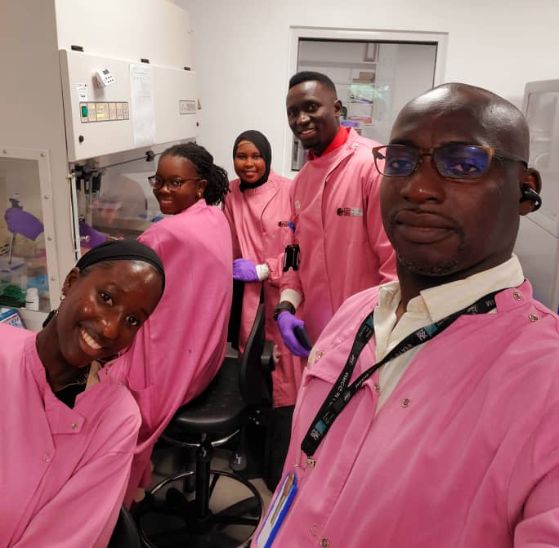
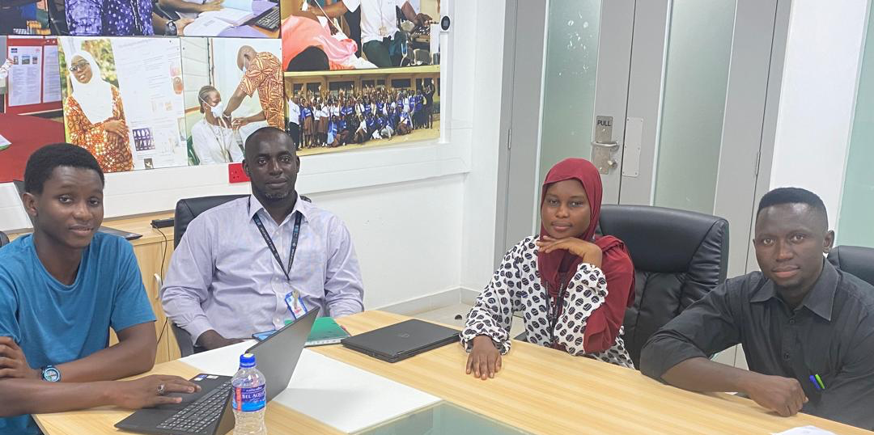


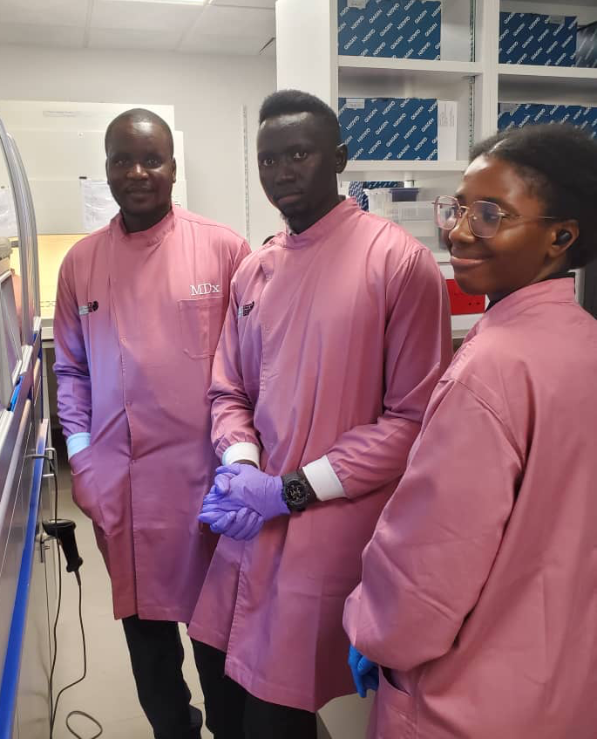
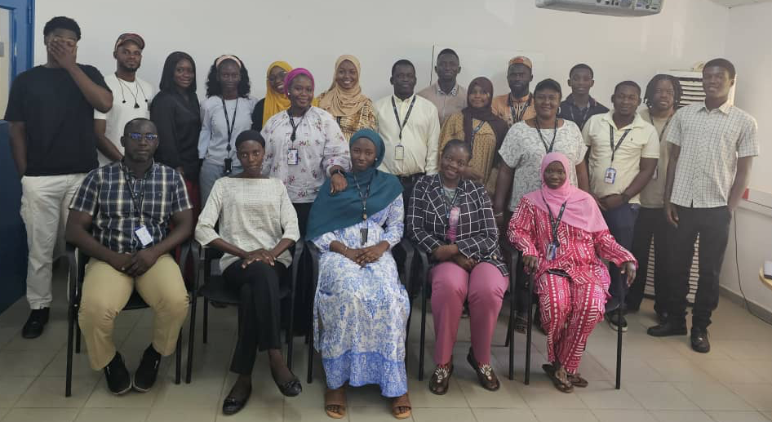

Acknowledgements
African Post Doctoral Training Initiative (APTI)
5

Slide 8
Thank You
Questions & Discussion
Sulayman Sowe
Computational biologist
ssulayman636@gmail.com | github.com/sulayman-sowe | +220 835125465

